Slide 1
Involvement in applied health and care research in London
Dr Jane Stafford
Associate director of operations

Slide 2
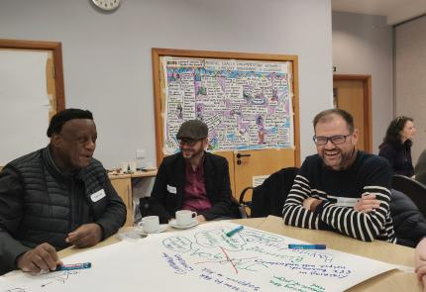
Value of involvement in health and care research
For research
Improved relevance
For the public
Empowerment
Increased influence
For researchers
Deeper understanding
Increased motivation
Better design
Enhanced credibility
Increased transparency
Better communication
Greater impact
Diverse representation
Better connections
Notes:
The value of involving patients, service users, carers and members of the public in health and care research is widely recognised:
Benefits for the research
Improved relevance: Research focuses on what matters to patients, leading to outcomes that are more useful to them and their communities.
Better design: Studies are designed with the patient experience in mind, leading to greater accessibility and higher participant recruitment and retention.
Enhanced credibility: Including lived experience brings invaluable, unique insights that make studies more credible.
Increased transparency: Public involvement builds trust and accountability throughout the research process.
Better communication: Patient and public input can help ensure that research results are communicated in a way that is understandable and useful to participants.
Benefits for the public
Empowerment: Patients and the public gain skills, confidence, and knowledge about health conditions and the research process.
Increased influence: They have a direct say in shaping research, influencing care, and improving health and social care services.
Greater impact: Their input helps bring about tangible improvements to healthcare.
Diverse representation: It ensures that the perspectives of diverse communities, who are often under-represented, are included, leading to more inclusive and culturally appropriate research.
Benefits for researchers
Deeper understanding: Researchers gain a better understanding of the patient perspective and the needs of the communities who will benefit from their work.
Increased motivation: Working with patients and the public can increase researchers' motivation by showing them the direct impact of their work.
Better connections: It helps researchers feel more purposeful and better connected to the people their research is intended to help.

Slide 3

NIHR Strategic Commitments for Public Partnerships 2025-2030
Embed research inclusion
Strengthen partnerships
Improve reward and recognition
Require feedback
Strengthen capability and capacity
Notes:
NIHR is a large funder of research, receiving funding from the Department of Health and Social Care. They work in partnership with the NHS, universities, local government, other research funders, patients and the public – to fund research that improves people's health and wellbeing.
NIHR recognises that patients, service users, carers and the public play a vital role in research, drawing on their lived experience of health and care issues.
NIHR has a long track record in this work, which they refer to as public partnerships, and in order to stay up to date and keep advancing, they published their first Strategic Commitments for Public Partnerships to improve how they work with patients, service-users, carers and the public.
They represent priorities across 5 key areas where NIHR has recognised they should get better and go further:
Embed research inclusion: Make sustained progress in widening research participation and increasing the diversity of the public and communities who participate in, shape and deliver research.
Strengthen partnerships: between researchers and communities to better reflect the diversity of the population.
Improve reward and recognition: so that it is more equitable, efficient and consistent.
Require feedback: to the public and communities on their contributions.
Strengthen capability and capacity: including training and peer support.

Slide 4
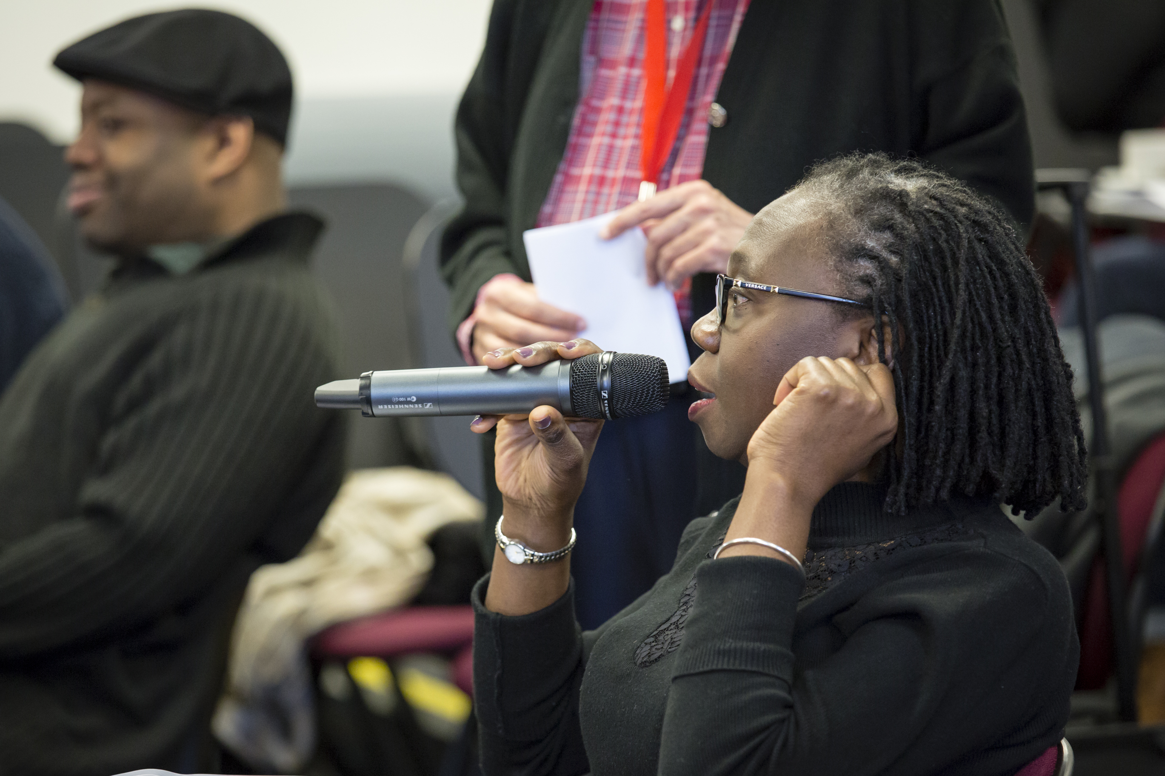
NIHR ARC South London goals
Notes:
In South London involving patients, service users, carers and members of the public in all our research has been a top priority for us, along with our goals of:
prioritising the needs of people with multiple health conditions
Better understanding and addressing health and care inequalities in our society

Slide 5
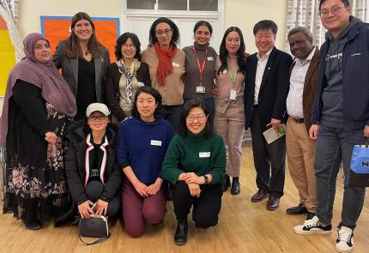
Areas of focus for involvement
Involvement in governance
Developing contributors’ skills and knowledge for more in-depth roles
Involving groups and networks
Inclusive involvement addressing health and care inequalities
Notes:
I will spend a few minutes reflecting on our achievements and experiences at ARC South London in relation to the areas that we have selected as breakout group topics, which the discussion can build on and consider for a future applied research programme in London:
Involvement in governance, at organisational and theme level
Developing contributors’ skills and knowledge for more in-depth roles, e.g. being co-authors, peer research
Involving groups and networks (e.g. for patients, carers, communities): partnerships beyond individual level
Inclusive involvement addressing health and care inequalities.
Pictured: Research Cafe session in Kingston in collaboration with Mind in Kingston's Magpie Project.

Slide 6
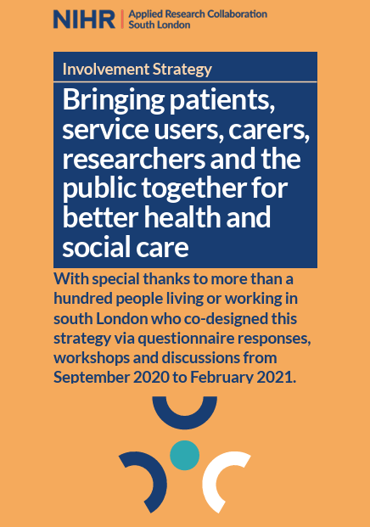

Involvement in governance
Co-designed our Involvement Strategy
Board and executive public member representation
Established an Involvement Advisory Group
Notes:
We worked with more than 100 people, including local people from diverse backgrounds, user groups and researchers to co-design our Involvement Strategy
One of the commitments from our strategy was to appoint public contributors and community organisational representatives to serve on our Board and Executive.
Another was to set up an Involvement Advisory Group – bringing together public members and staff. As well as advising on the ARC’s PPIE evaluation framework, the group contributed to other ARC activities (e.g. around capacity building)

Slide 7
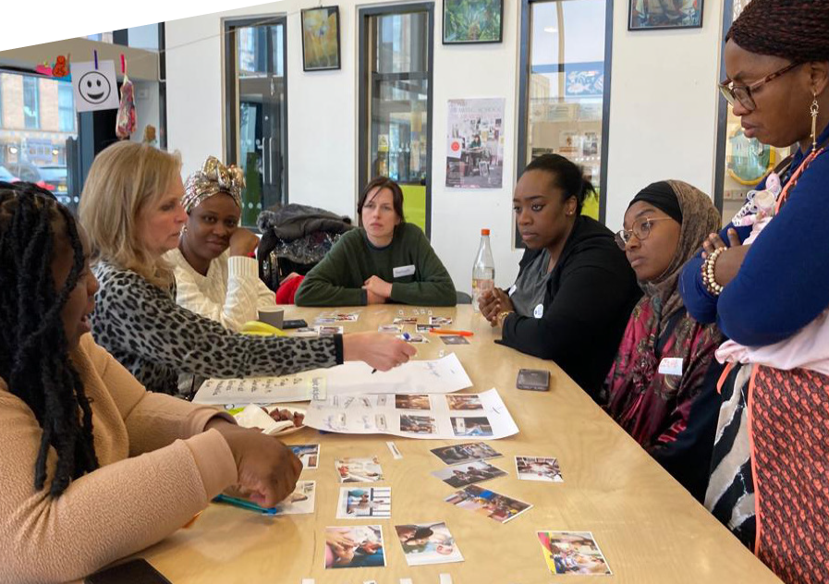
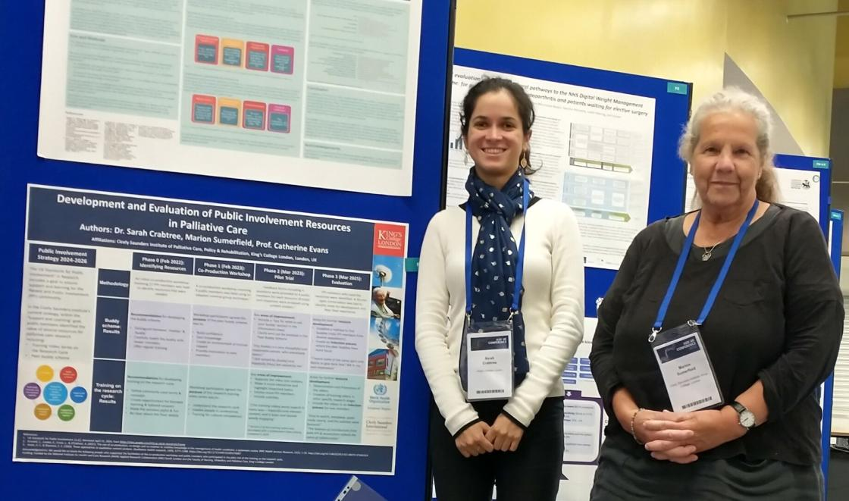
Developing contributors’ skills and knowledge
Trained peer researchers
Training public contributors
Lived experience contributors have co-authored papers
Notes:
A key achievement for ARC South London is that we have trained public members as peer researchers. For example, members of the Maternity and Perinatal Mental Health PPIE advisory group were trained in Photovoice methods and journalling, a participatory research method and public members were trained in our PPIR theme to conduct interviews and will also be analysing data.
The capacity building and involvement teams also provided training for public contributors on strengthening contributor knowledge and skills.
Diverse lived experience contributors and researchers have co-authored papers within our research themes and presented / taken part in conference (pictured bottom: Marion Sumerfield and Sarah Crabtree, PPI and staff co-leads for the Cicely Saunders Institute Palliative Care's Public Involvement Strategy Group, presented new resources at this year’s Health Services Research UK Conference in Newcastle)

Slide 8
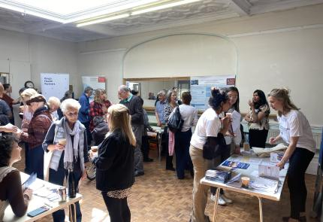
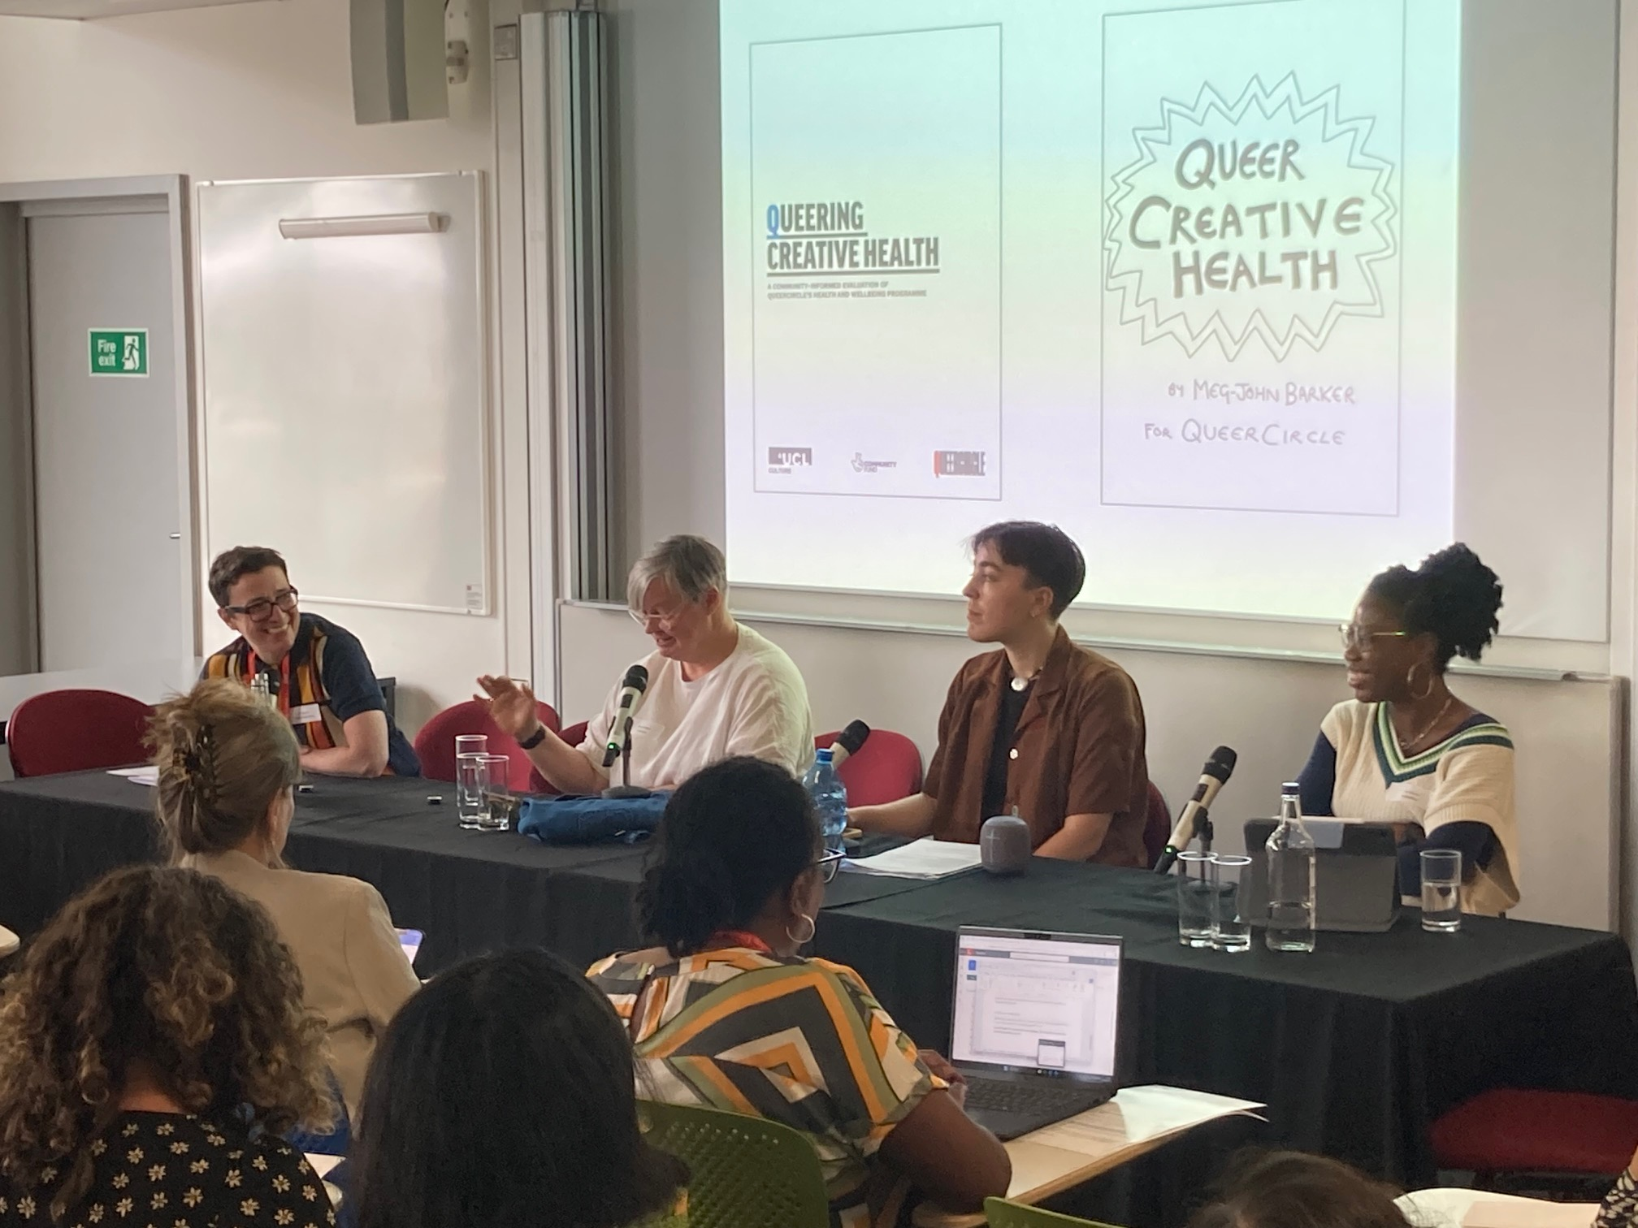
Involving groups and networks
Dementia Community Research Network
Collaboration with people with lived experience and charities by maternity and perinatal mental health researchers
Speakers from community organisations at research events
Notes:
We established the Dementia Community Research Network, which consists of people with lived experience, families and carers, community partners and dementia researchers who work together to improve care for people affected by dementia and increase the opportunities for participation in research and public involvement. The network has held two well-attended public engagement events.
Our maternity and perinatal mental health researchers have collaborated widely with people with lived experience and charities.
Two public contributors from the Involvement Advisory Group and two community organisational representatives (from Ladies in Waiting, a women’s local community group and Mosaic Clubhouse, a community group in Lambeth supporting people with mental health) members of the ARC board and executive have spoken at ARC events.
Pictured bottom: Dr Frances Williams, health and research lead, QUEERCIRCLE speaking as part of a panel at this year’s Knowledge Exchange event

Slide 9
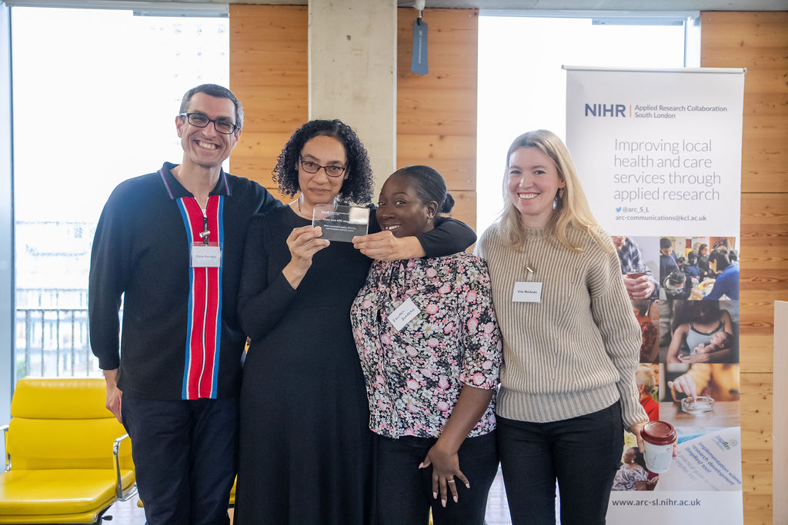
Inclusive involvement addressing health and care inequalities
Created resources in different languages to help reach underserved communities
Diverse Public Research Panel provided feedback to researchers on projects
Made a video with Patient and Family Group members on involving people with communication difficulties after stroke
Co-developed a public involvement strategy for palliative and end of life care research
Notes:
Our palliative and end life care researchers have created resources in different languages to help reach underserved communities. Their resources are tailored to languages most widely spoken in the UK.
Our diverse Public Research Panel of diverse public members has provided feedback to researchers on projects addressing health and care inequalities.
Our stroke researchers used ARC funding to make a video with a small group of Patient and Family Group members with communication difficulties after stroke to identify how we can make the PPI meetings a more suitable space for those with communication difficulties to participate.
Public contributors worked with researchers to co-develop a public involvement strategy for palliative and end of life care research, and were awarded a King’s College London Engaged Researcher Network (KERN) ‘Transforming research culture’ award.
Pictured: Dr Josephine Ocloo and some of the ARC South London Public Research Panel with award for most successful equity, diversity and inclusion activity at Know your ARC

Slide 10
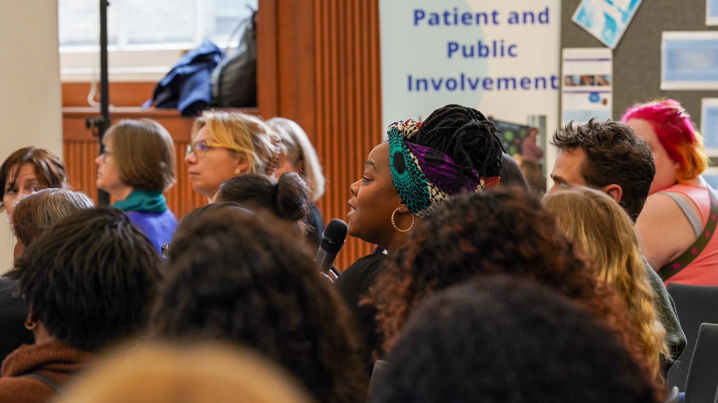
Future involvement
ARC South London ends in 2026
NIHR may fund Pan-London ARC
We plan to share and take forward learning from ARC South London and partners
Inclusive involvement which makes a difference is vital now and in the future
Notes:
ARC South London ends in 2026
NIHR may fund Pan-London ARC [projected to start in July 2026 and details yet to be decided)
We plan to share and take forward learning from ARC and partners [can mention that whatever happens next, those who have worked for and been involved in this ARC and partners will take what they have learned about involvement with them]
Inclusive involvement which makes a difference vital [now and in the future]

Slide 11
Find out more about involvement at ARC South London at:
www.arc-sl.nihr.ac.uk/involving-patients-public

